Slide 1

Artificial Intelligence for Augmented Reality
CSE Team 33: Kerwin Mercado and Ethan Hansen
Advisor: Hanna Aknouche-Martinsson
Sponsor: Electric Boat

Slide 2
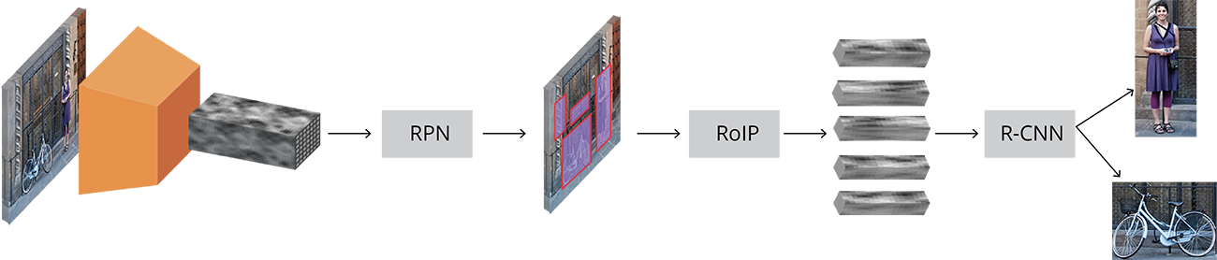
Fundamentals of the Faster R-CNN
Passes input images as Height x Width x Depth tensors
Passed through pre-trained CNN
Region Proposal Network (RPN)
Finds regions where objects may be (predefined objects)
Anchors placed throughout the image
Is this anchor relevant? How do we adjust the anchor?
Region of Interest Pooling (RoLP)

Slide 3
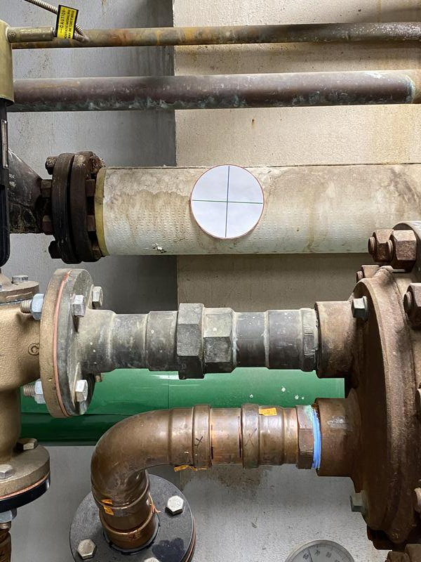
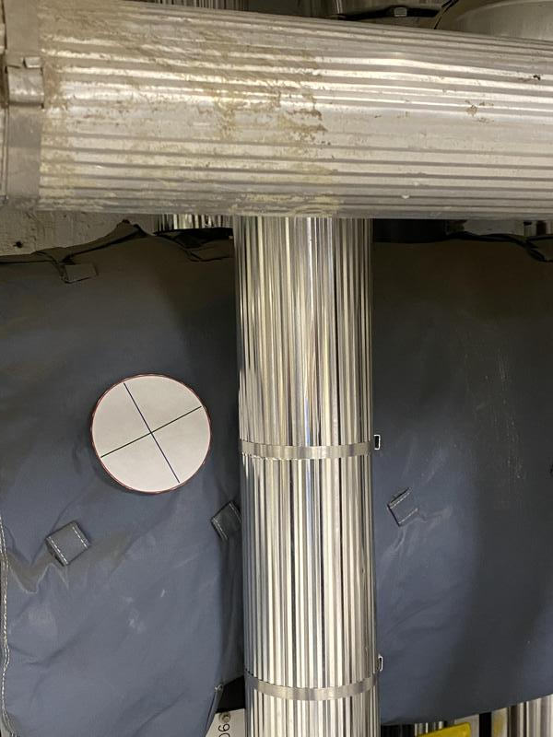
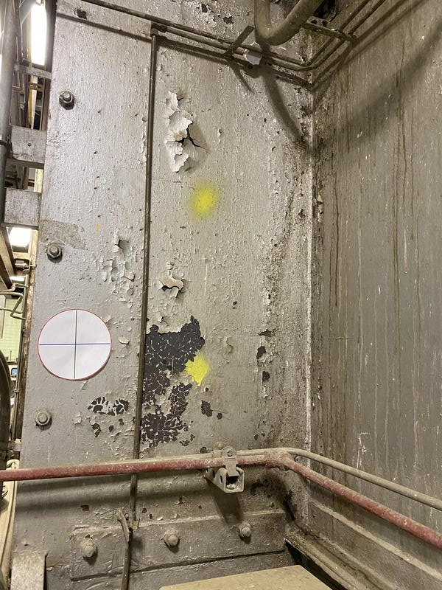
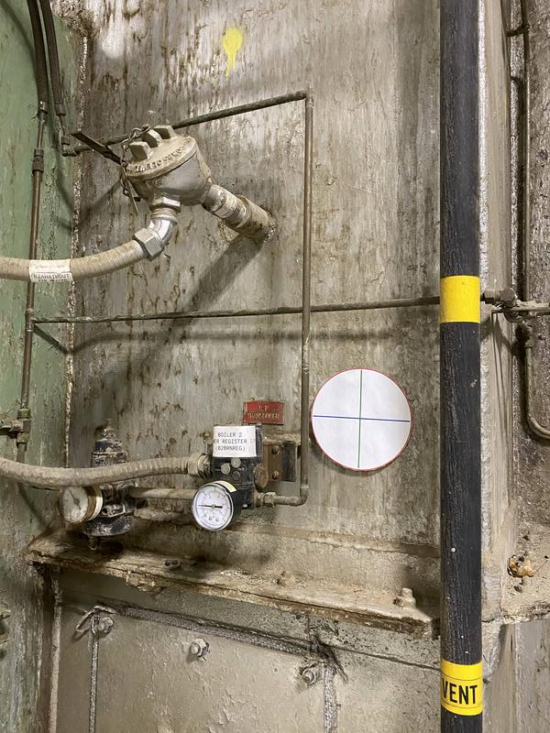
Making a Dataset
Similar environment, small images
Divide images into two folders, train and test
Despite the naming convention, both are used during training
Should be equal or training set should be larger
Create regions for each photo in each folder using labelimg(https://tzutalin.github.io/labelImg/)

Slide 4
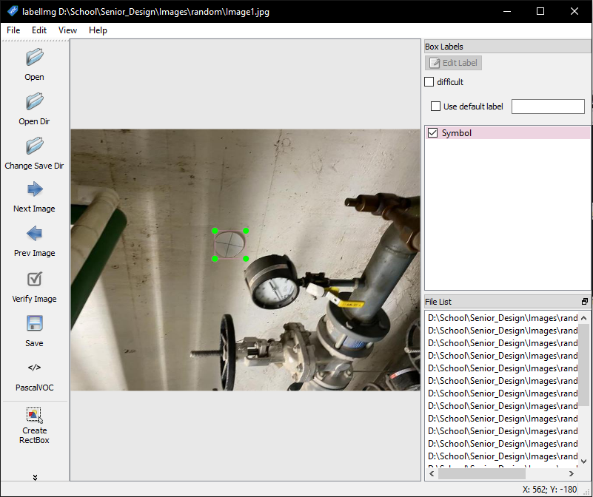
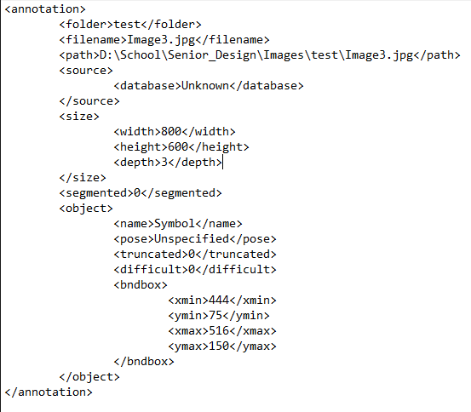
Labelimg Program
Load directory
“Create RectBox”
Saves a (.xml)
Labelimg Program
.xml file example

Slide 5
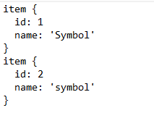
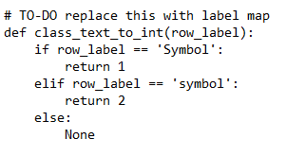
Setting Up the Model
Convert .xml’s to .csv
Need to be .csv for use with opencv library
Raccoon dataset used for conversion (https://github.com/datitran/raccoon_dataset)
Generating TFRecords
Constructs labels
Make a Label Map (PBTXT)
Label Map
generate_tfrecord.py

Slide 6
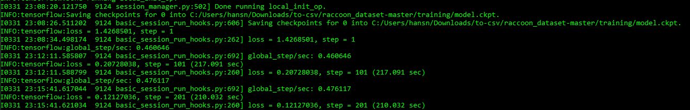
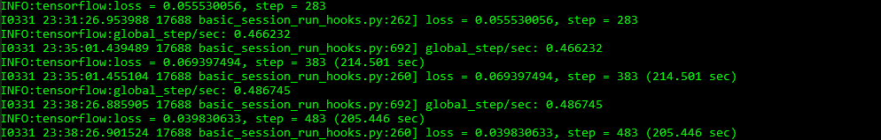
Training
Used faster_rcnn_inception_v2_pets model from https://github.com/tensorflow/models/blob/master/research/object_detection/g3doc/detection_model_zoo.md
Training statistics using 82 image dataset:
Index 1 - 282
Index 283 - 568

Slide 7
Testing with Only 12 Image Dataset, Large Images (3042 x 4032)

Slide 8
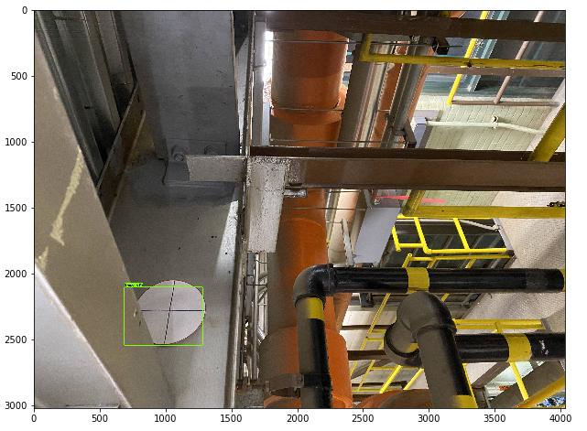
Bounding Box Coordinates:
y1: 2087.6355171203613
x1: 680.6570291519165
y2: 2525.736451148987
x2: 1270.1170444488525
Bounding Box Center:
x: 975.3870368003845
y: 2306.685984134674

Slide 9
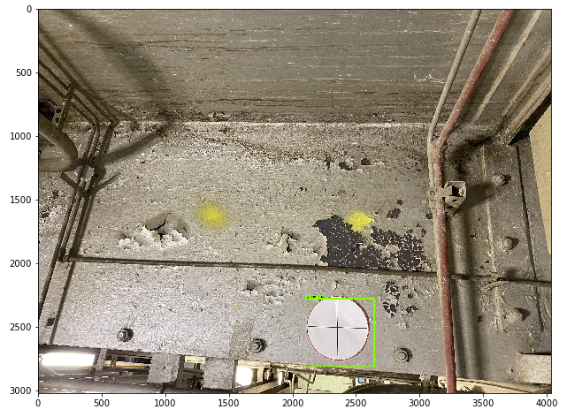
Bounding Box Coordinates:
y1: 2262.320637702942
x1: 2084.2742919921875
y2: 2789.5880341529846
x2: 2621.572732925415
Bounding Box Center:
x: 2352.9235124588013
y: 2525.9543359279633

Slide 10
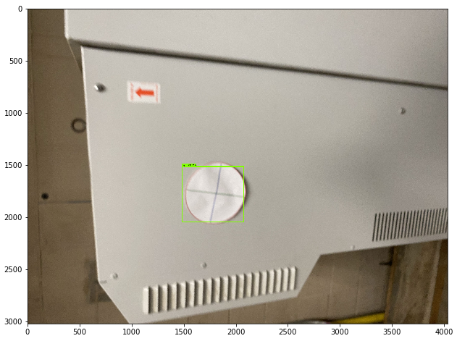
Bounding Box Coordinates: y1: 1504.8274397850037 x1: 1471.0259437561035 y2: 2028.3342003822327 x2: 2058.553695678711
Bounding Box Center:
x: 1764.7898197174072
y: 1766.5808200836182

Slide 11
Testing with 82 Images Dataset, Smaller Images (800 x 600)

Slide 12
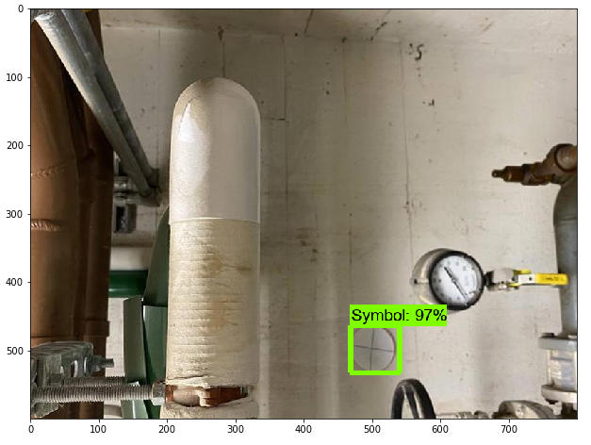
Bounding Box Coordinates: y1: 464.3664479255676 x1: 468.39709281921387 y2: 532.3178887367249 x2: 541.8785095214844
Bounding Box Center:
x: 505.1378011703491
y: 498.34216833114624

Slide 13
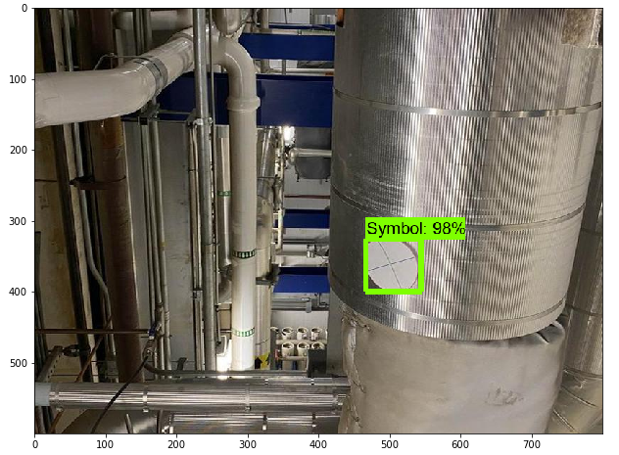
Bounding Box Coordinates: y1: 326.3183355331421 x1: 466.417932510376
y2: 399.0673542022705 x2: 545.1869010925293
Bounding Box Center:
x: 505.80241680145264
y: 362.6928448677063

